Slide 1


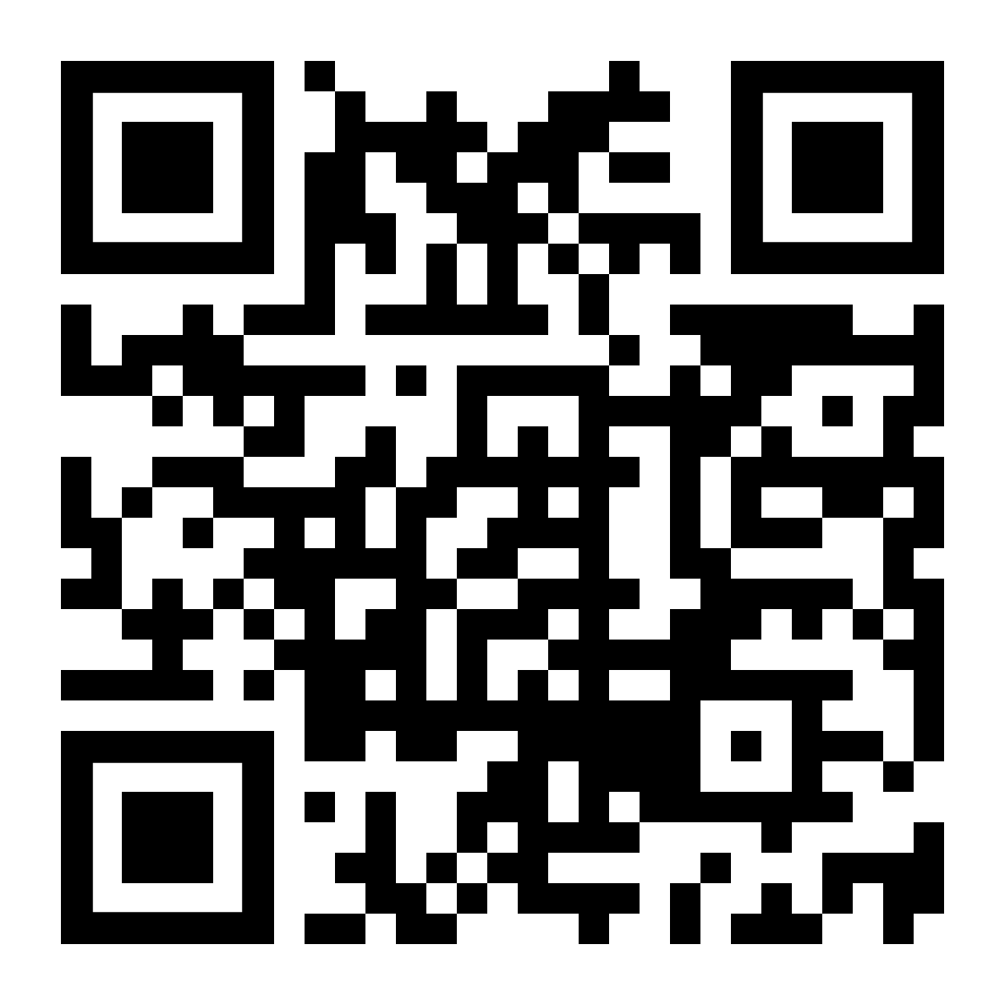



INTEGRATION PATTERNS IN MODULAR MONOLITH APPLICATIONS
Follow me on Twitter
Halil İbrahim KALKAN
Volosoft, Co-founder
@hibrahimkalkan
@hikalkan

Slide 2
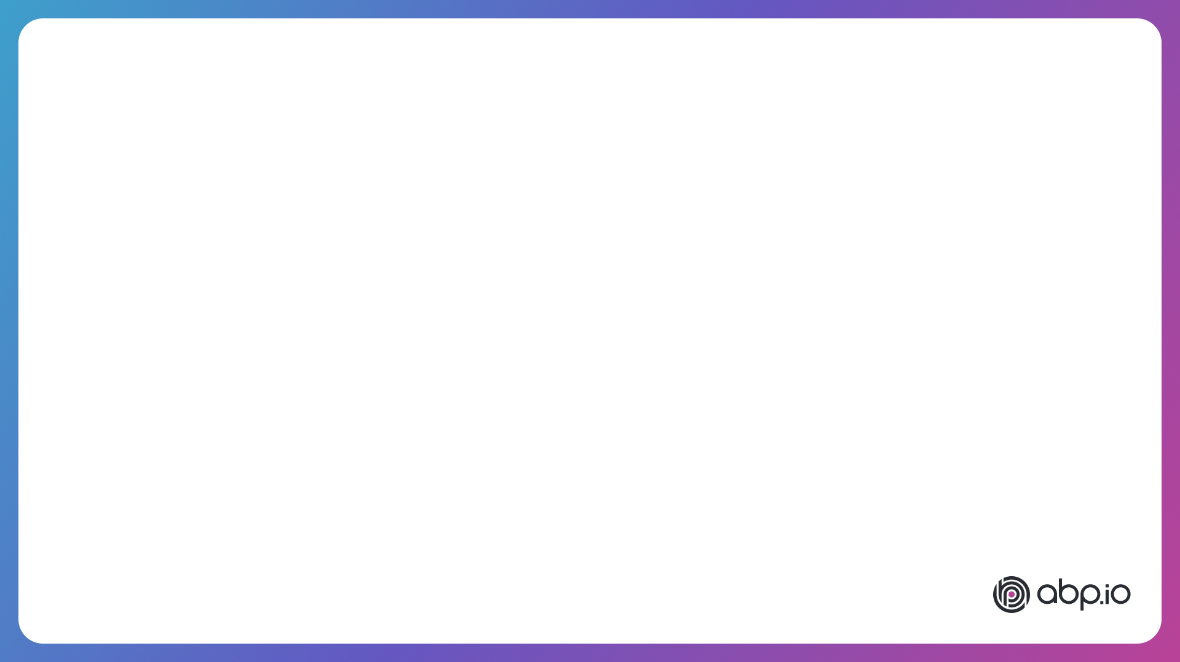
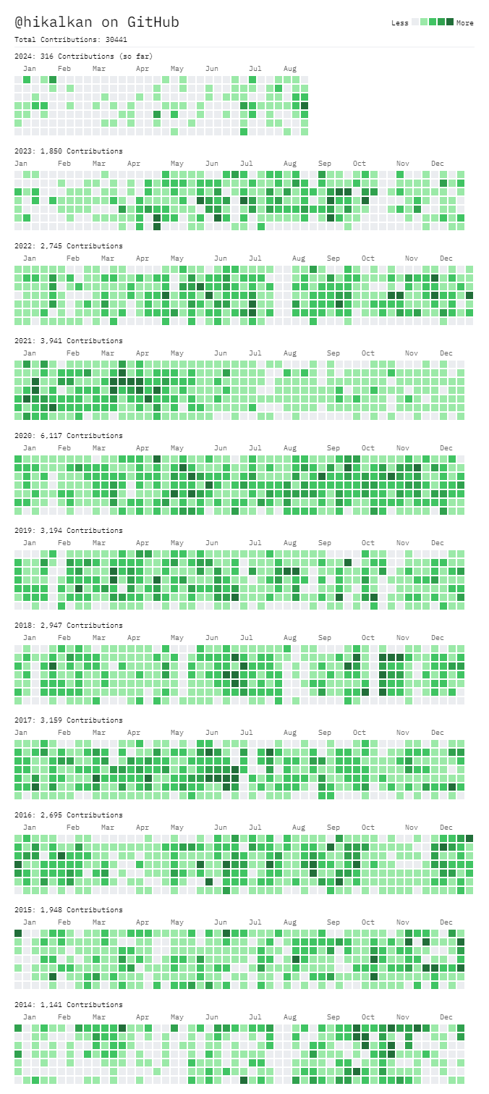







ABOUT ME: HALİL İBRAHİM KALKAN
1997, Started programming (at 14 years old, with Turbo Pascal)
2003-2007, Computer Engineering
2007 - 2015: Software developer, software architect, team leader
2013 - ∞: Lead developer of the open source ABP Framework
2016 - ∞: Co-founder, software architect
Multi-threading, distributed/microservice systems, OOP, DDD, software architectures.. etc.
Still active coder, open-source contributor
30,000+ total contributions on GitHub

Slide 3
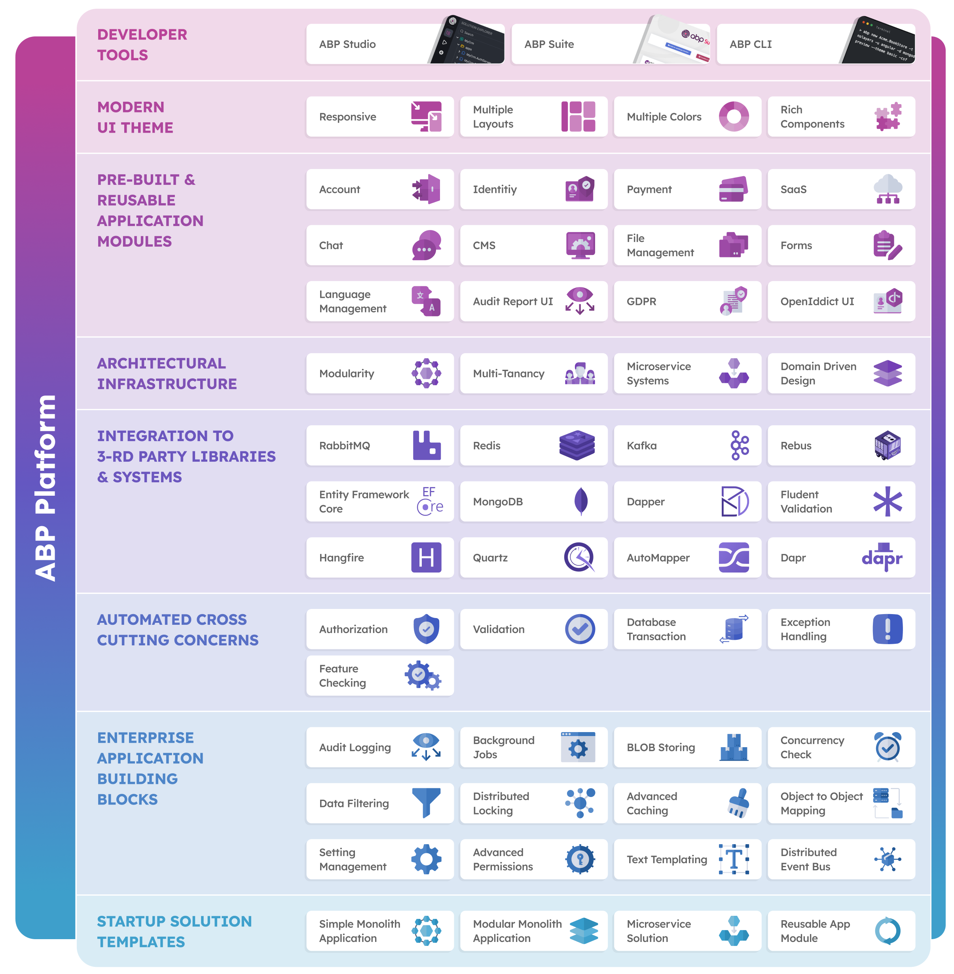
THE ABP PLATFORM
25 Reusable application modules
All modules;
Supports EF Core & MongoDB
Supports MVC, Blazor, Angular UI
Supports modular monolith & microservice scenarios
Supports tiered architecture
Extensible & customizable
Fully layered
Independent of any business
Independent from each other
Good test coverage

Slide 4
AGENDA
Why modularity?
Architectural options - Database - Codebase - User Interface
Integration - Designing module dependencies - Communication types - Transaction management
Specialized modules (utils, common, aggregator, reporting, etc)
Best practices
Migrating to microservices

Slide 5
TITLE
TODO

Slide 6
TITLE
TODO

Slide 7
TITLE
TODO

Slide 8
TITLE
TODO

Slide 9
TITLE
TODO

Slide 10
TITLE
TODO

Slide 11
TITLE
TODO

Slide 12
TITLE
TODO

Slide 13
TITLE
TODO

Slide 14

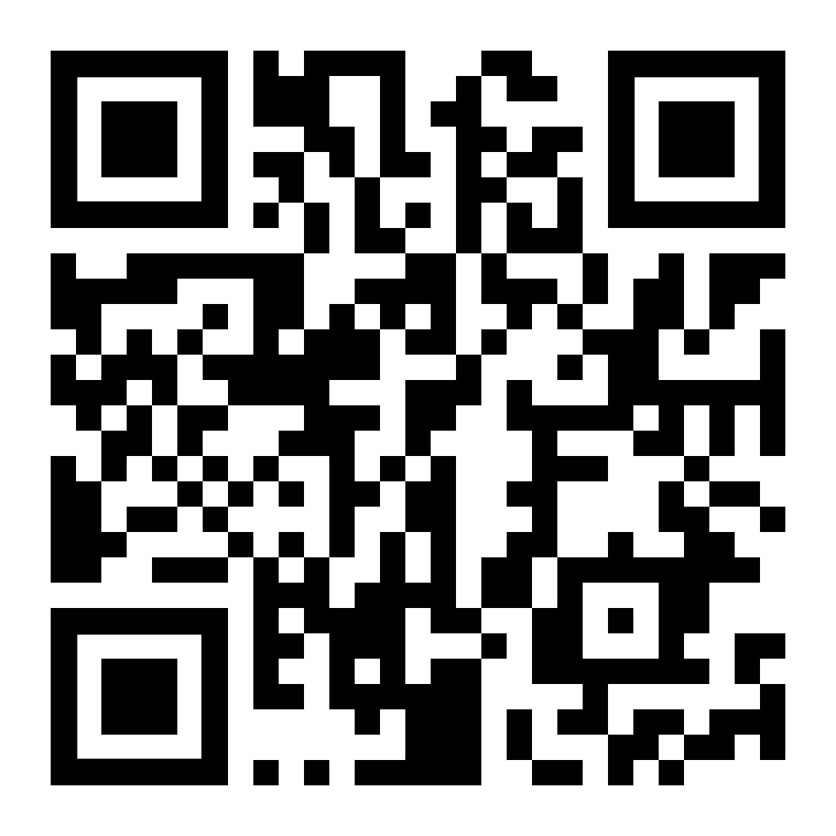
Download This Presentation
THANK FOR
WATCHING
Halil İbrahim KALKAN
Volosoft, Co-founder
@hibrahimkalkan
@hikalkan

